Slide 1

Customer Shopping Behavior Analysis
Uncovering insights into spending patterns, customer segments, product preferences, and subscription behavior to guide strategic business decisions.

Slide 2

Project Overview
Goal
Data Scope
Analyze 3,900 purchases to understand customer behavior and inform business strategy.
Transactional data covering demographics, purchase details, and shopping behavior.
Key Insights
Focus on spending patterns, customer segmentation, product preferences, and subscription impact.

Slide 3
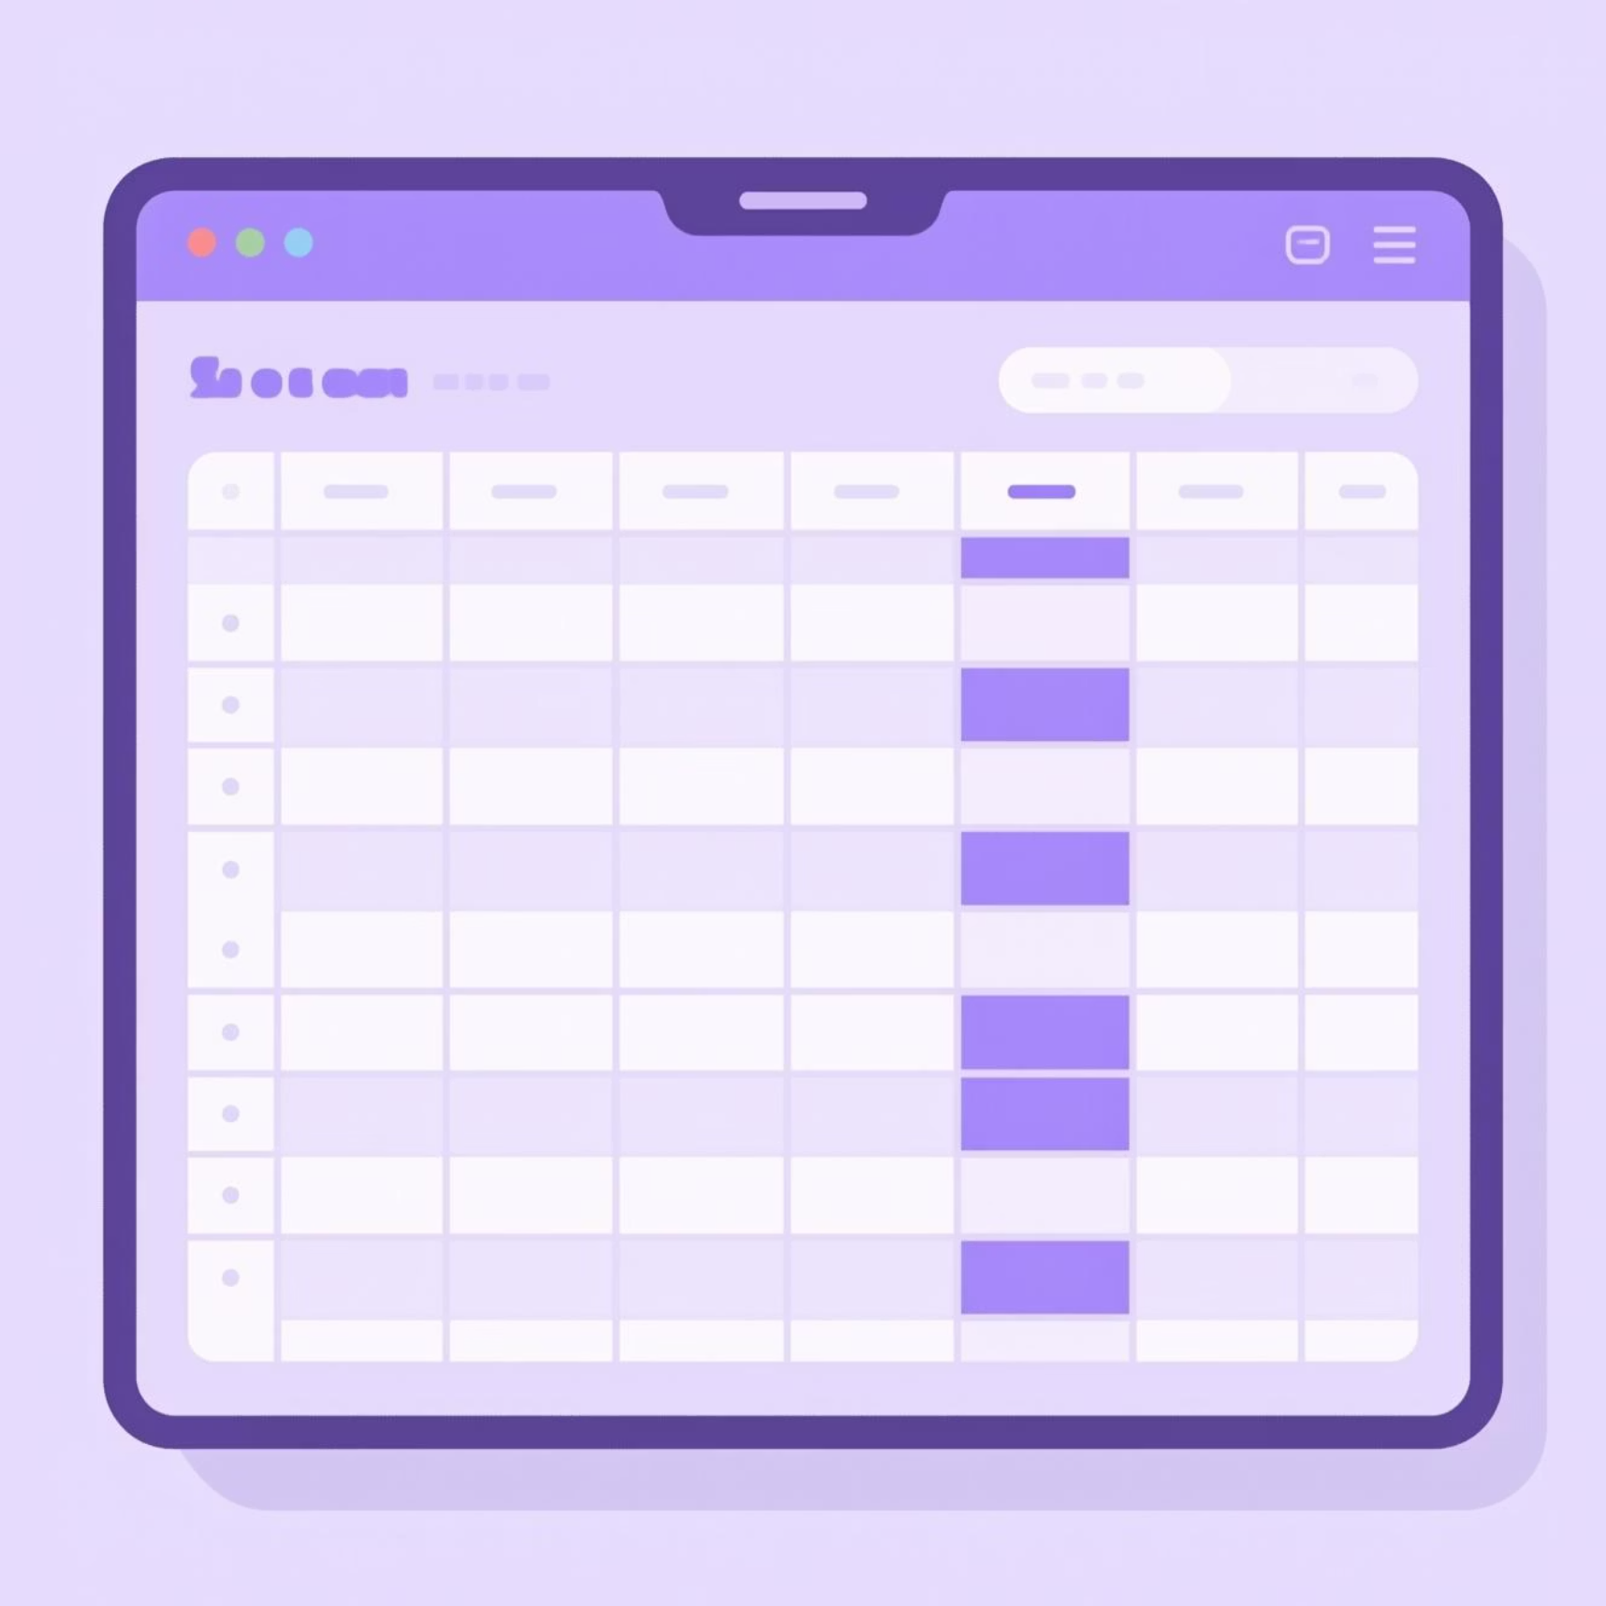
Dataset Summary
Dataset Size
3,900 rows and 18 columns of transactional data.
Key Features
Customer demographics (Age, Gender, Location, Subscription Status)
Purchase details (Item, Category, Amount, Season, Size, Color)
Shopping behavior (Discount, Promo Code, Previous Purchases, Frequency, Review Rating, Shipping)
Missing Data
37 missing values in the "Review Rating" column.

Slide 4
Exploratory Data Analysis (Python)
01
02
03
Data Loading & Exploration
Missing Data Handling
Column Standardization
Imported dataset with pandas; checked structure and summary statistics.
Imputed missing "Review Rating" values using median per product category.
Renamed columns to snake_case for improved readability.
04
05
Feature Engineering
Database Integration
Created 'age_group' and 'purchase_frequency_days' columns.
Loaded cleaned data into PostgreSQL for SQL analysis.

Slide 5





Data Analysis (SQL) - Key Findings
Revenue by Gender
High-Spending Discount Users
Top 5 Products by Rating
Male customers generated higher revenue ($157,890) than female customers ($75,191).
Gloves, Sandals, Boots, Hat, and Skirt received the highest average review ratings.
Identified 839 customers who used discounts but spent above average.

Slide 6
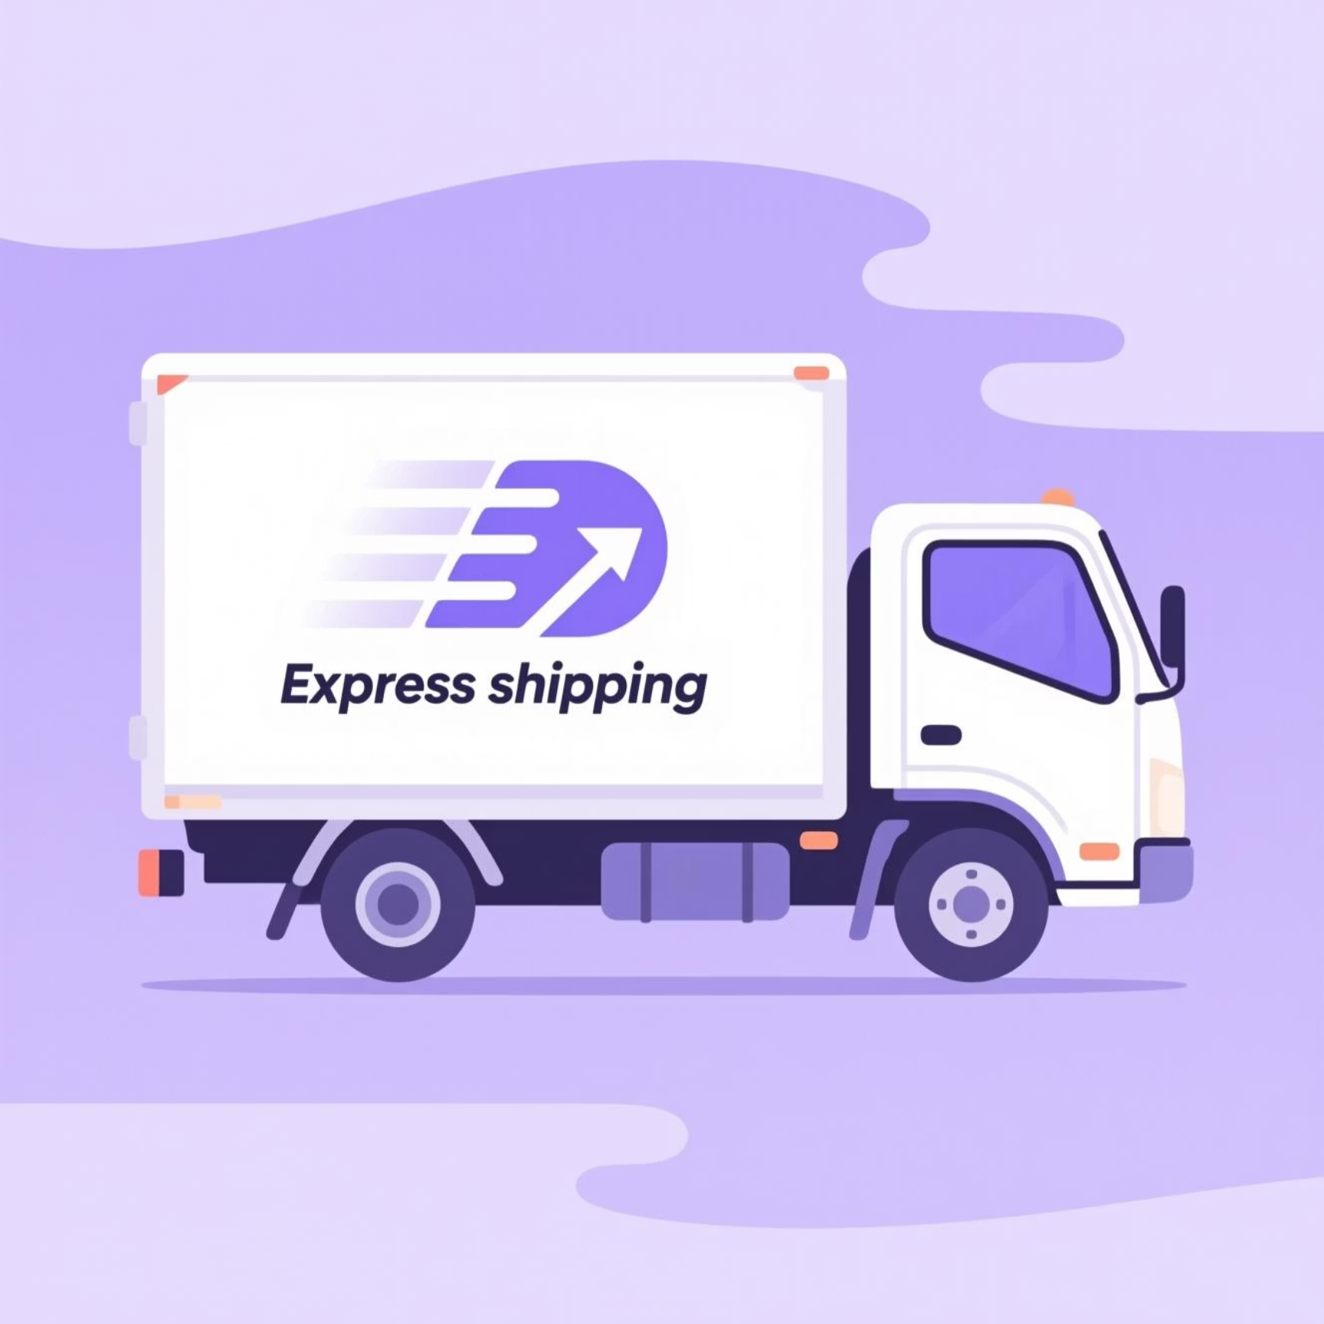
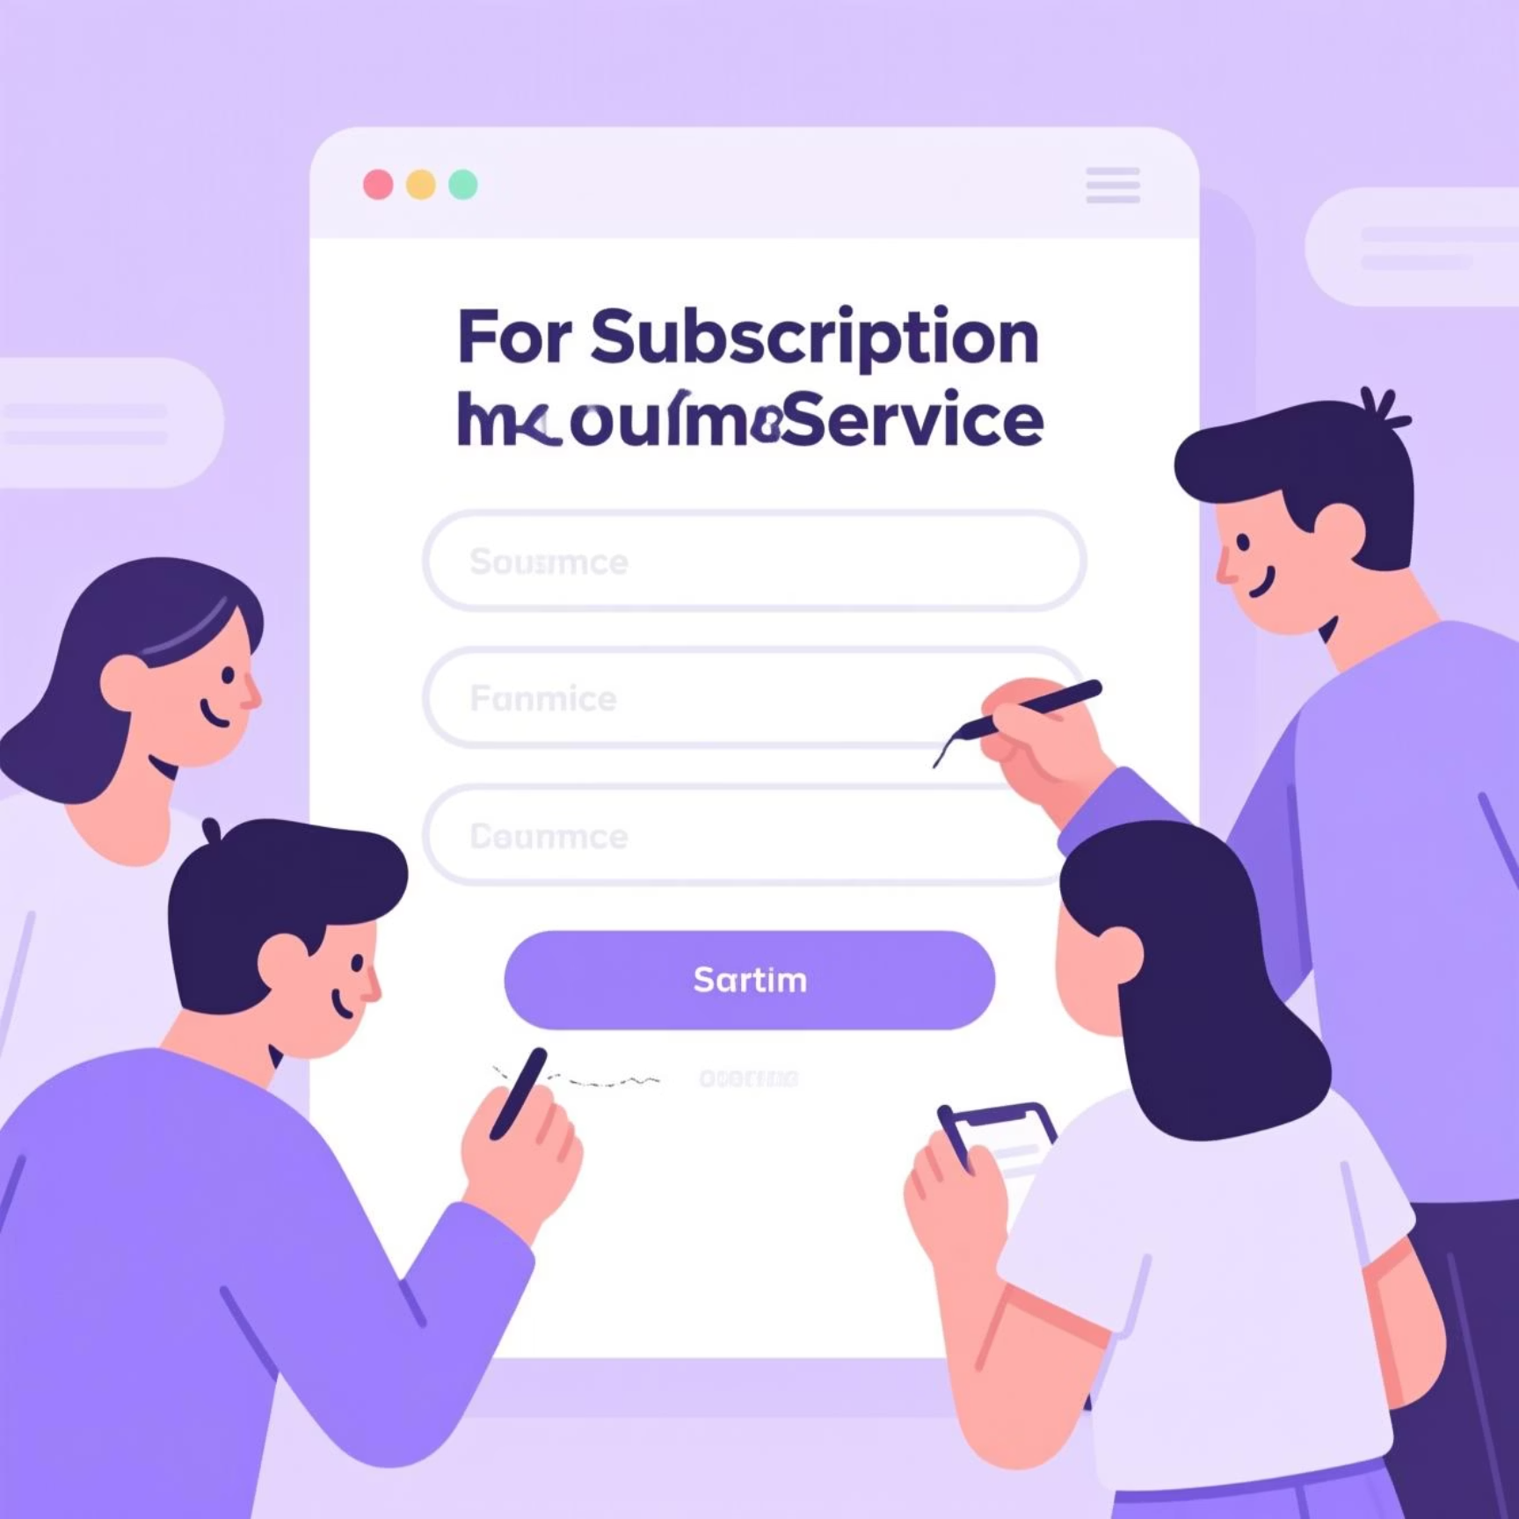
Shipping & Subscription Insights
Shipping Type Comparison
Subscribers vs. Non-Subscribers
Express shipping users had a slightly higher average purchase amount ($60.48) than Standard shipping ($58.46).
Non-subscribers (2847) contributed more total revenue ($170,436) than subscribers (1053) ($62,645), with similar average spend.

Slide 7

Product & Customer Segmentation
1
2
Discount-Dependent Products
Customer Segmentation
Hat (50%), Sneakers (49.66%), Coat (49.07%), Sweater (48.17%), and Pants (47.37%) had the highest discount rates.
Loyal (3116), Returning (701), and New (83) segments identified based on purchase history.

Slide 8
Top Products by Category
1
Accessories
Jewelry
171
1
Clothing
Blouse
171
1
Footwear
Sandals
160
1
Outerwear
Jacket
163
This table highlights the most purchased items within each product category, indicating strong demand for these specific products.

Slide 9


Repeat Buyers & Revenue by Age Group
Repeat Buyers & Subscriptions
Revenue by Age Group
Customers with more than 5 purchases are more likely to be non-subscribers (2518) than subscribers (958).
Young Adults generated the highest revenue ($62,143), followed by Middle-aged ($59,197), Adult ($55,978), and Senior ($55,763).

Slide 10
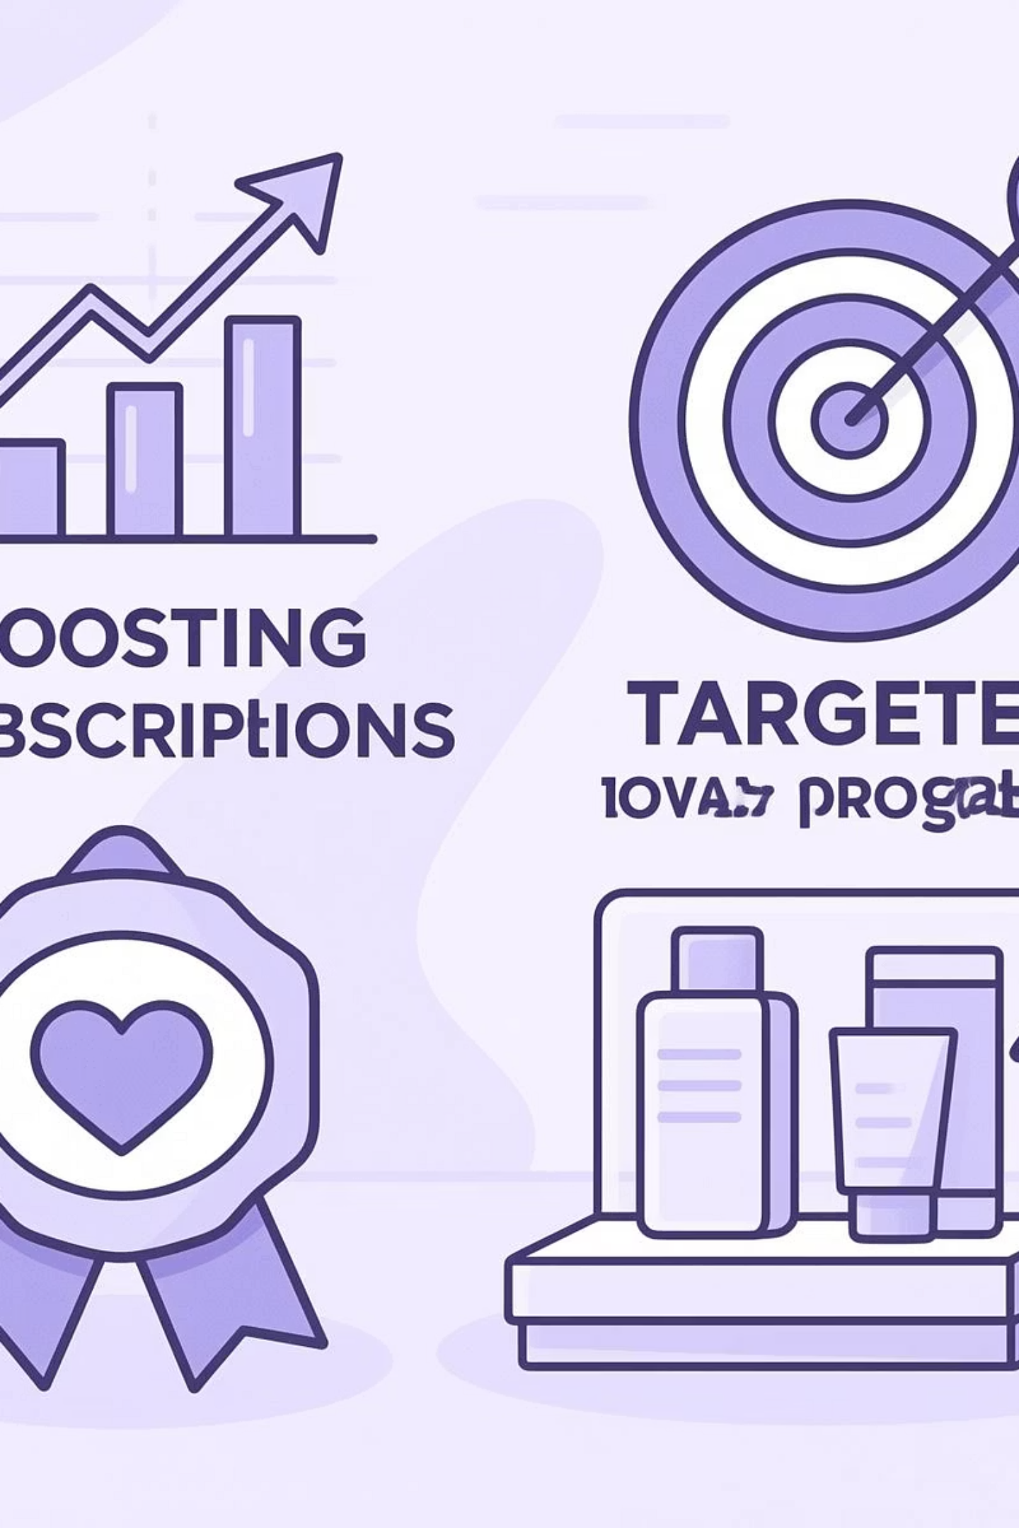




Business Recommendations
Boost Subscriptions
Promote exclusive benefits to increase subscriber base.
Customer Loyalty Programs
Reward repeat buyers to foster loyalty and move them to the "Loyal" segment.
Targeted Marketing
Focus efforts on high-revenue age groups and express-shipping users for maximum impact.
Product Positioning
Highlight top-rated and best-selling products in marketing campaigns.
Notes:
The key recommendations for boosting the business are: Promote exclusive subscriber benefits to grow the subscriber base Implement a customer loyalty program to reward repeat buyers and move them to the "Loyal" segment Focus marketing efforts on high-revenue age groups and express-shipping users for maximum impact Highlight the company's top-rated and best-selling products in marketing campaigns

